Slide 1

Cloud Infrastructure & System Administration Intern
INTERNSHIP VIVA
30-Nov-2025
[EA2432251010355]
Utkarsh Srivastava

Slide 2

CONTENTS
Abstract
Introduction
Analysis & Requirements
Problem Description
Design Phase
Implementation Phase
Testing Phase
Conclusion
Appendices
Screenshots
References

Slide 3
ABSTRACT
This internship at Ansys Software Pvt Ltd provided valuable hands-on experience in the field of Cloud Infrastructure Support using AWS And Azure. The internship was aimed at enhancing my practical understanding of cloud computing concepts, system administration practices, and enterprise IT infrastructure management.
During the internship, I worked on provisioning and configuring virtual machines, managing cloud storage solutions, designing virtual networks, and setting up identity and access management policies. I was also involved in monitoring system performance, ensuring data security and compliance, and supporting backup and disaster recovery operations.
Through active collaboration with the Cloud Infrastructure team, I gained exposure to hybrid cloud environments, automation tools, and best practices in maintaining high availability and scalability. This internship not only strengthened my knowledge of AWS but also improved my problem-solving and technical support skills, which are essential for a career in Cloud Infrastructure and System Administration.

Slide 4

INTRODUCTION
Ansys Software Pvt Ltd is a global leader in engineering simulation software, delivering innovative solutions to help customers design . and optimize products. The Cloud Infrastructure & System Administration team plays a critical role in enabling secure and scalable cloud services to support global operations. My role as a System Administrator Intern included contributing to the setup, monitoring, and support of AWS & Azure resources. This internship provided me with exposure to real-world enterprise cloud operations, including hybrid deployments and security management.

Slide 5

Analysis & Requirement
The Cloud Infrastructure Support internship required both technical and analytical skills for managing IT infrastructure in the cloud.
Skills & Knowledge Required: - Networking fundamentals, Linux/Windows administration, and virtualization. - AWS services such as EC2, S3, IAM, and VPC. - Azure services such as Virtual Machines, Blob Storage, Virtual Networks, and Azure Active Directory.
Tools & Technologies Used: - AWS Console, Azure Portal, CLI, and PowerShell. - Cloud monitoring tools like AWS CloudWatch and Azure Monitor.

Slide 6
Problem Description
Internship divided into 6 core modules:
Identity & Access Management
Compute Management
Storage & Backup
Networking
Monitoring & Logging
Security & Compliance

Slide 7
Design Phase
Cloud Infrastructure Layout
Organized Identity, Compute, Storage, Networking
Security Architecture
IAM roles, Azure AD groups, MFA policies
Data Flow Design
S3/Blob/EC2/VM communication
Backup & redundancy paths
Monitoring Design
CloudWatch dashboards
Azure Monitor alerts

Slide 8
AWS Implementation
Created IAM users, groups, roles
Provisioned EC2 instances
Configured S3 buckets with lifecycle policies
Setup CloudWatch metrics & alarms
Automated tasks using AWS CLI
Implemented Lambda-based scheduled backups

Slide 9
Azure Implementation
Created Azure AD users & groups
Provisioned Virtual Machines
Configured Blob storage containers
Setup NSGs & firewall rules
Configured Azure Monitor dashboards
Automated tasks with PowerShell scripts
.

Slide 10
Automation
Automated server provisioning
Backup scheduling using Lambda & Azure Automation
CLI & PowerShell for bulk deployments
Monitoring alerts configured using automated rules

Slide 11
Testing Phase
Functional Testing:
IAM permissions
VM/EC2 connectivity
Backup & restore workflows
Security Testing:
Encryption checks
Pen-testing for open ports
Load Testing:
AWS CloudWatch
Azure Load Testing

Slide 12
CONCLUSION
Internship provided strong foundation in cloud & system administration
Gained hands-on experience in security, monitoring, automation
Improved troubleshooting, cloud provisioning, and team collaboration skills
Ready for roles in Cloud Infra, DevOps and System Administration

Slide 13
Appendices
Tools & Technologies Used
AWS Tasks Performed
Architecture Diagrams
Scripts & Configurations
Screenshots

Slide 14
Screenshots
AWS Console
EC2 Instances
S3 Bucket
Azure Portal
VM Details

Slide 15
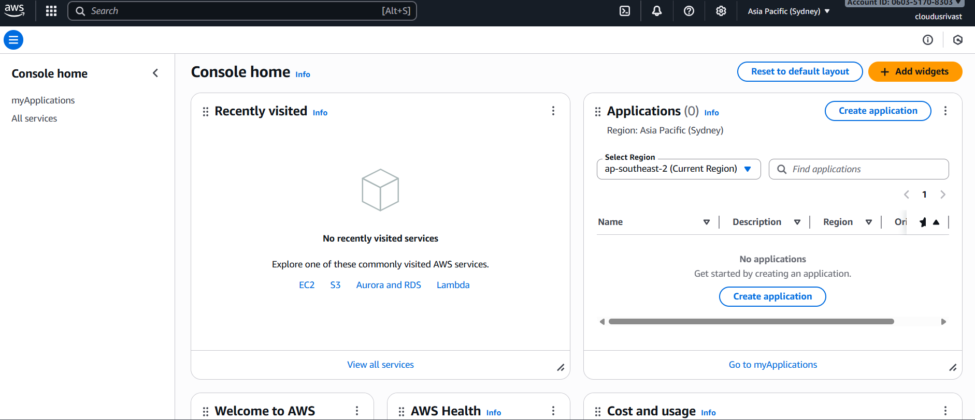
SCREENSHOT
AWS Console

Slide 16
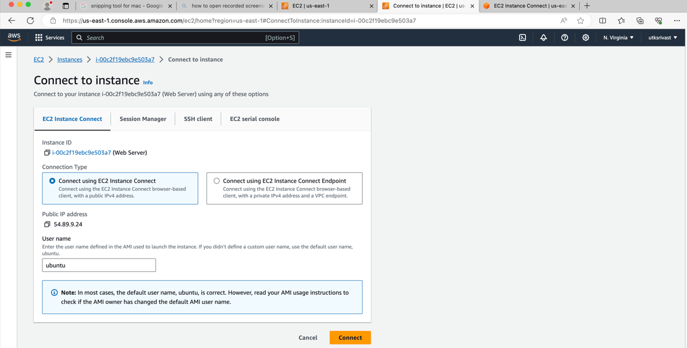
SCREENSHOT
EC2 Instance

Slide 17
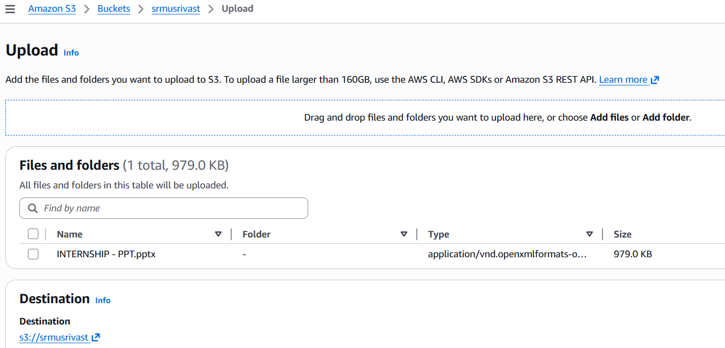
SCREENSHOT
S3 Bucket

Slide 18
References
AWS Documentation
Azure Documentation
AWS Well-Architected Framework
Microsoft Architecture Center
Ansys Internal Documentation
Cloud Security Alliance

Slide 19
THANK YOU

